Slide 1
Physics-Informed Neural Network (PINN)
Based on:
A PINN framework for generic bioreactor modelling
Pre by :
WANG Zezhong & ZHAO Yuxi
Notes:
Today I will present our work on Physics-Informed Neural Networks (PINNs) applied to a fed-batch bioreactor system.

Slide 2
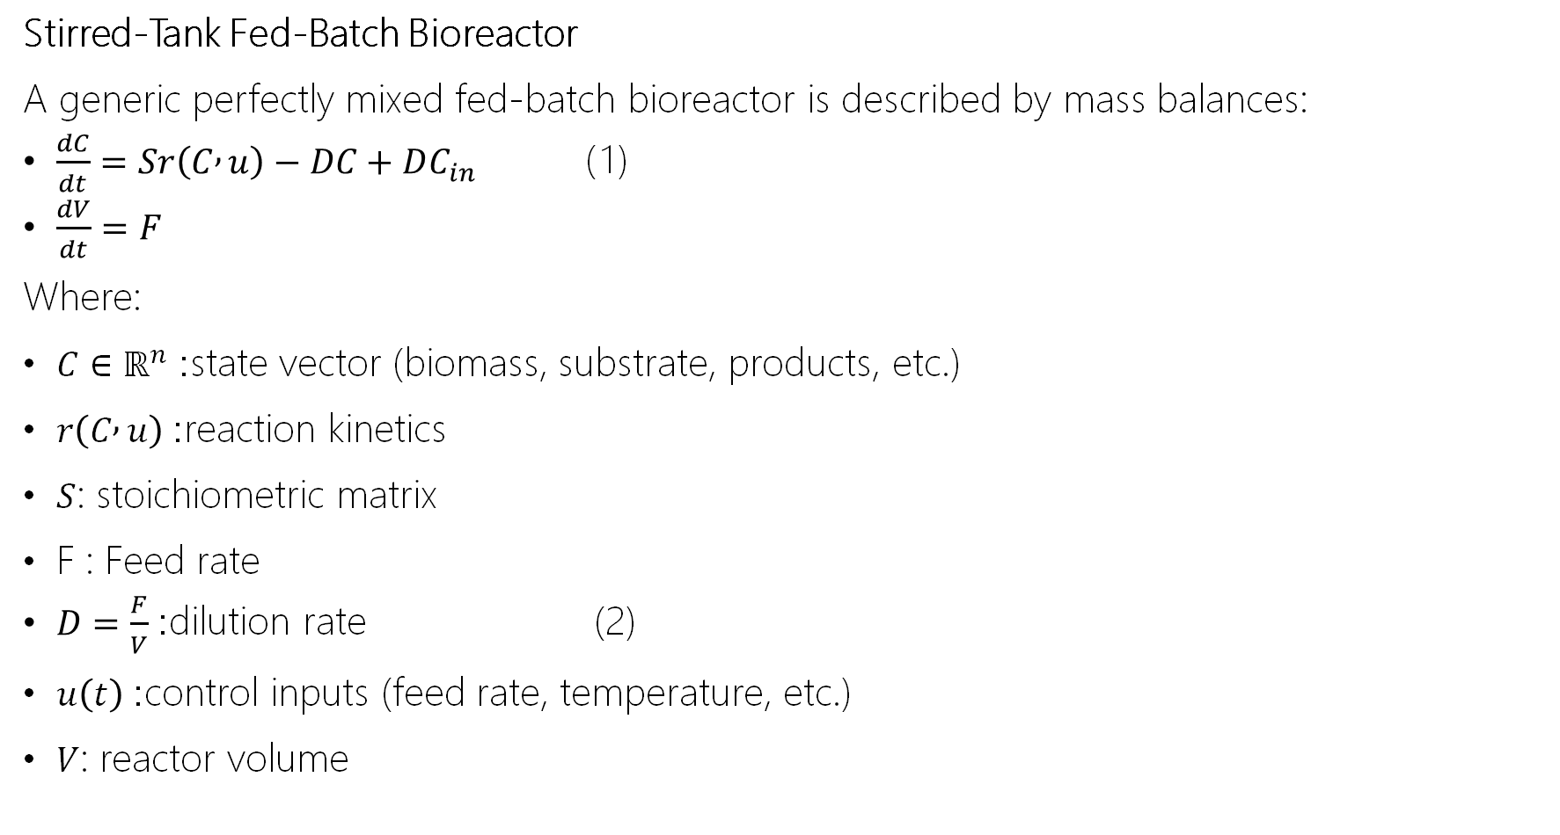
Back Ground definition
Stirred-Tank Fed-Batch Bioreactor
A generic perfectly mixed fed-batch bioreactor is described by mass balances:
$\frac{dC}{dt}=Sr\left(C , u\right)−DC+DC_{in}$ （1）
$\frac{dV}{dt}=F$
Where:
$C∈ℝ^{n}$: state vector (biomass, substrate, products, etc.)
$r\left(C , u\right)$: reaction kinetics
$S$: stoichiometric matrix
F : Feed rate
$D=\frac{F}{V}$: dilution rate (2)
$u\left(t\right)$: control inputs (feed rate, temperature, etc.)
$V$: reactor volume

Slide 3
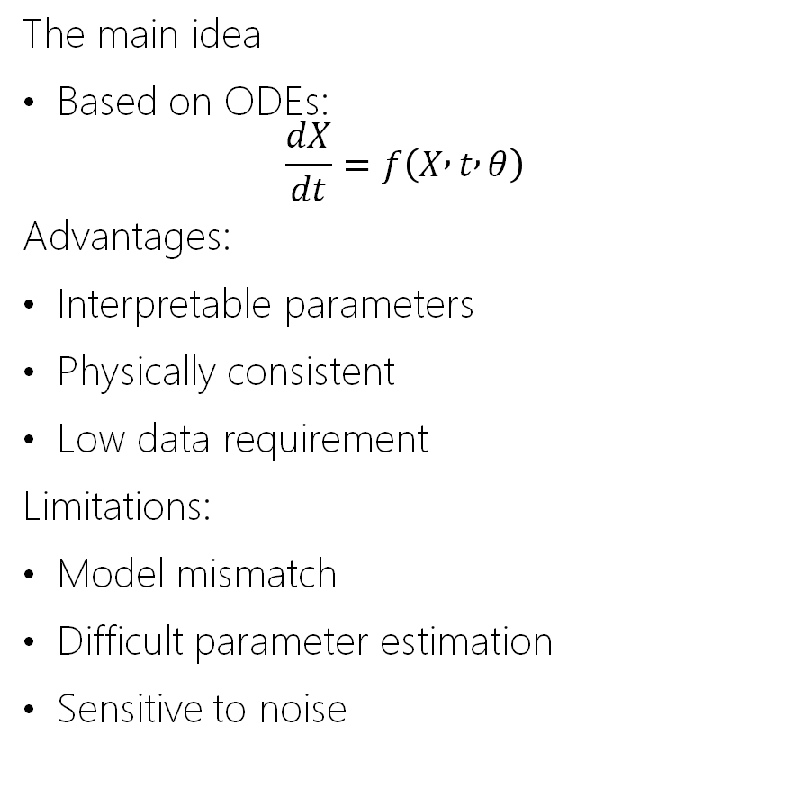
Traditional Approaches & Limitations
Classical mechanistic modeling Pure data-driven neural networks
The main idea
Based on ODEs:
$$\frac{dX}{dt}=f\left(X , t , θ\right)$$
Advantages:
Interpretable parameters
Physically consistent
Low data requirement
Limitations:
Model mismatch
Difficult parameter estimation
Sensitive to noise
The main idea
X(t)=Nθ​(t)
Advantages:
Strong fitting capability
No need for explicit equations
Limitations:
No physical guarantee
Poor extrapolation
Large data requirement
Can we combine physical laws and neural networks in a unified framework?

Slide 4
Introducing PINNs

Slide 5
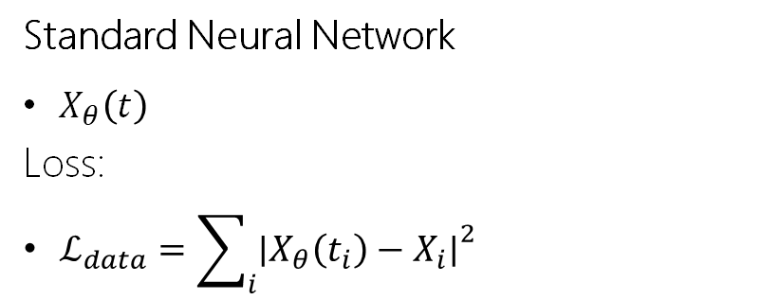
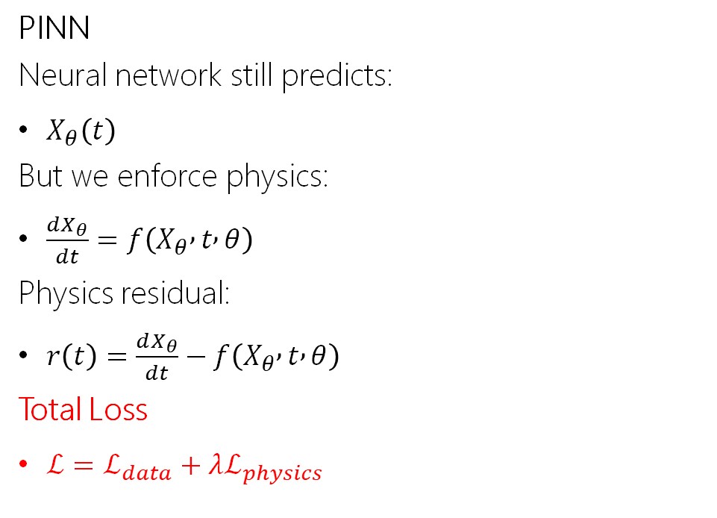
Main Idea
A Physics-Informed Neural Network (PINN) combines:
Data fitting
Physical laws (ODEs or PDEs)
PINN
Neural network still predicts:
$X_{θ}\left(t\right)$
But we enforce physics:
$\frac{dX_{θ}}{dt}=f\left(X_{θ} , t , θ\right)$
Physics residual:
$r\left(t\right)=\frac{dX_{θ}}{dt}−f\left(X_{θ} , t , θ\right)$
Total Loss
$ℒ=ℒ_{data}+λℒ_{physics}$
Standard Neural Network
$X_{θ}\left(t\right)$
Loss:
$ℒ_{data}=\sum_{i}{{∣X_{θ}\left(t_{i}\right)−X_{i}∣}^{2}}$

Slide 6
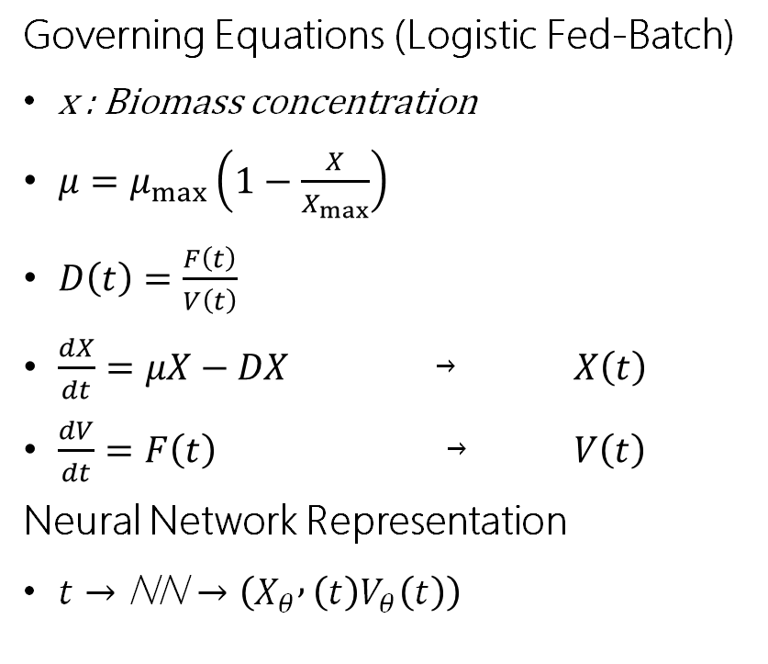
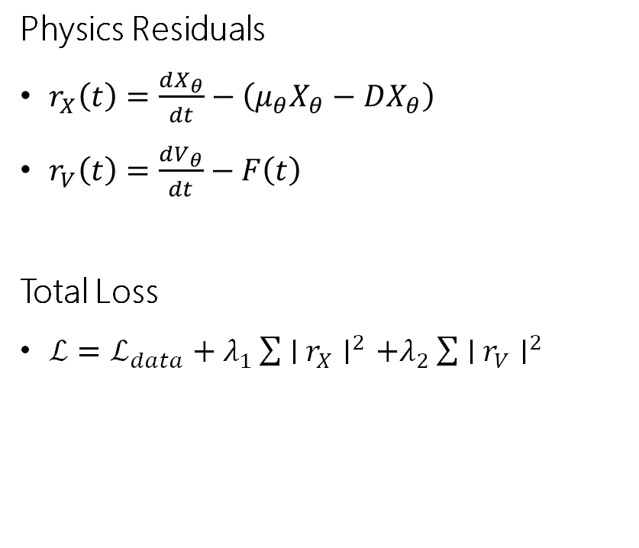
PINN Formulation for Fed-Batch System
Governing Equations (Logistic Fed-Batch)
x : Biomass concentration
$μ=μ_{max}\left(1−\frac{X}{X_{max}}\right)$
$D\left(t\right)=\frac{F\left(t\right)}{V\left(t\right)}$
$\frac{dX}{dt}=μX−DX$ ￫ $X\left(t\right)$
$\frac{dV}{dt}=F\left(t\right)$ ￫ $V\left(t\right)$
Neural Network Representation
$t→\text{NN}→\left(X_{θ} , \left(t\right)V_{θ}\left(t\right)\right)$
Physics Residuals
$r_{X}\left(t\right)=\frac{dX_{θ}}{dt}−\left(μ_{θ}X_{θ}−DX_{θ}\right)$
$r_{V}\left(t\right)=\frac{dV_{θ}}{dt}−F\left(t\right)$
Total Loss
$ℒ=ℒ_{data}+λ_{1}\sum{∣}r_{X}∣^{2}+λ_{2}\sum{∣}r_{V}∣^{2}$

Slide 7
EXPERIMENTAL STUDY

Slide 8
EXPERIMENTAL STUDY
Data source & measured variables
Data are taken from data.csv[1] containing multi-batch fed-batch experiments.
Each sample includes time t hours, noisy measurements X,S,Pt,Pm,V and the input feed rate F.
X (g/L): Biomass concentration S(g/L): Substrate concentration
Pt (g/L) : Total product concentration
Pm(g/L) : Secreted product concentration
The file also provides corresponding noise free trajectories Xtrue,Strue,Pt,true,Pm,true used only for evaluation.
Fixed process constants used in the physics model: Sin=20g and yield Y=7.3

Slide 9
Batch level partition
EXPERIMENTAL STUDY
We use a batch-level split to avoid leakage between train and test trajectories.
Test set: Batch 16 (annotated in code as an optimal control profile, most meaningful for extrapolation).
Training set: Batches 1–15.
No explicit validation set in this version; generalization is promoted via stochastic batch sampling during training.

Slide 10
Initial conditions as inputs
EXPERIMENTAL STUDY
Initial conditions are extracted from the first point of each batch:
(X0 ,S0 ,Pt0 ,Pm0 )
and replicated across all samples of that batch.
The network learns a conditional mapping:
(X,S,Pt ,Pm )=fθ (τ,V,F,X0 ,S0 ,Pt0 ,Pm0 )
enabling one model to handle multiple batches with different initial states and inputs.
Inputs (7D):u=[τ, Vexact , F, X0 , S0 , Pt0 , Pm0 ]
Outputs (4D):y=[X, S, Pt , Pm ]
Architecture: 4 hidden layers, 128 neurons each, tanh activation

Slide 11
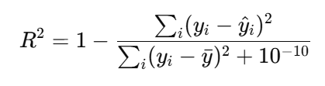
Training Protocol & Model Selection
EXPERIMENTAL STUDY
Training length: totalEpochs=50000.
Fixed loss weighting: λ=0.5.
Learning-rate schedule:10^{-4}10−3→5×10−4→10−4 (piecewise decay).
Model selection: every 500 epochs, compute test R^2 on Batch 16 for Pm; keep the best model.

Slide 12
Experimental results

Slide 13
Results Overview
Experimental results
We report:
(i) sensitivity to the loss weight λ
(ii) training convergence
(iii) accuracy metrics (R^2) on Train/Val/Test
(iv) time-series performance on the unseen Test batch (Batch 16).
The evaluation focuses on the four predicted states: X, S, Pt, Pm.
Batch 16 is used as the main generalization benchmark (unseen input profile).
Notes:
Now I move to the experimental results.
In this part, I will show four things.
First, I show how the loss weight lambda affects the training, so we can see the trade-off between data fitting and physics.
Second, I show the training convergence, with the loss curves.
Third, I show accuracy using R2（coefficient of determination） on train, validation, and test sets.
Finally, I show the time-series results on the unseen test batch, Batch 16.
In all results, we focus on the four predicted states.
Batch 16 is our main benchmark because its input profile is unseen during training.

Slide 14
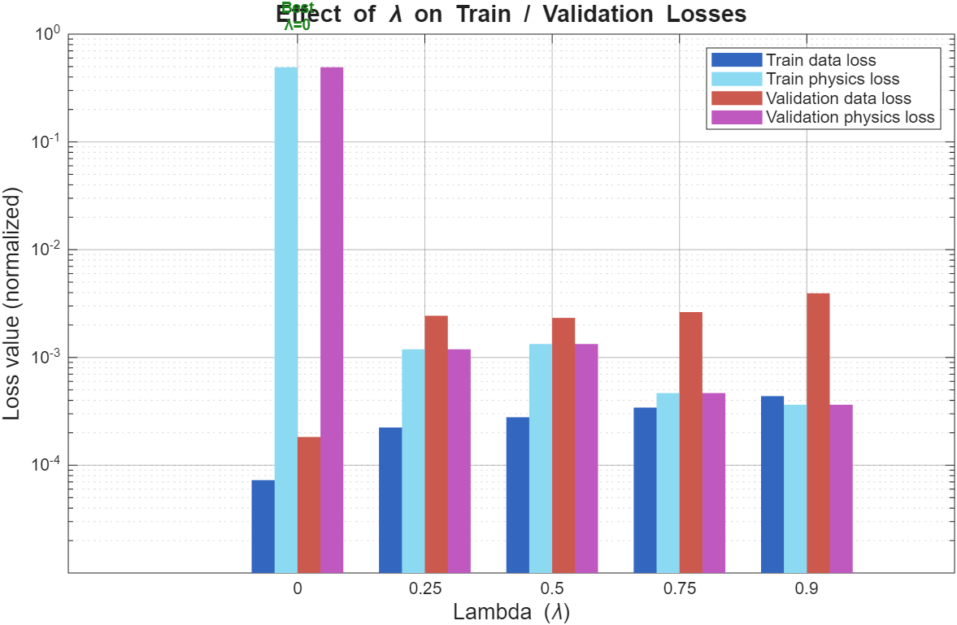
Effect of (Data vs Physics Trade-off)
Experimental results
Notes:
This slide shows the effect of λ.
λ controls the balance between data loss and physics loss.
When λ=0, the model only cares about data fitting.
So the data loss is small, but the physics loss is very large.
This means the model does not follow the physical equations well.
When we increase λ, the physics loss becomes much smaller.
But at the same time, the data loss can become larger.
So we have a clear trade-off: better physics consistency versus better data fitting.
From this plot, a middle value, around λ≈0.75, gives the best balance between train and validation losses.
So in the next results, we use a fixed λ close to this good region.

Slide 15
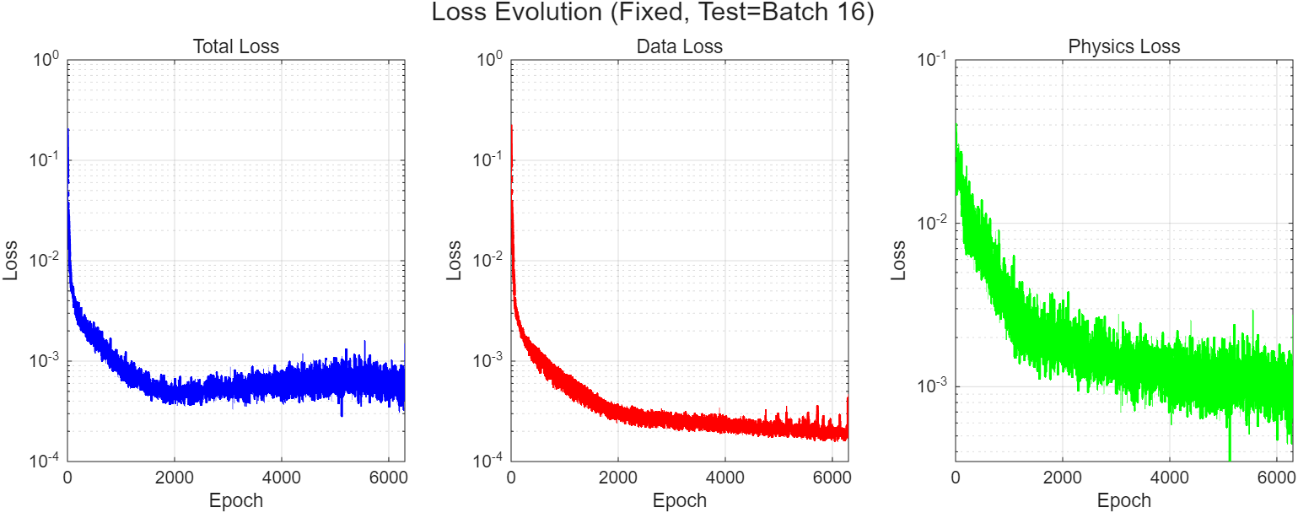
Training Convergence
Experimental results
Notes:
This slide shows the training convergence with a fixed λ, and the test is Batch 16.
We plot total loss, data loss, and physics loss versus epochs.
At the beginning, all losses drop fast.
This means the model learns the main pattern quickly.
Later, the losses decrease more slowly and reach a stable level.
We can also see small fluctuations, especially in physics loss.
This is normal because we sample batches and collocation points randomly during training.
Overall, the training is stable and the losses converge.

Slide 16
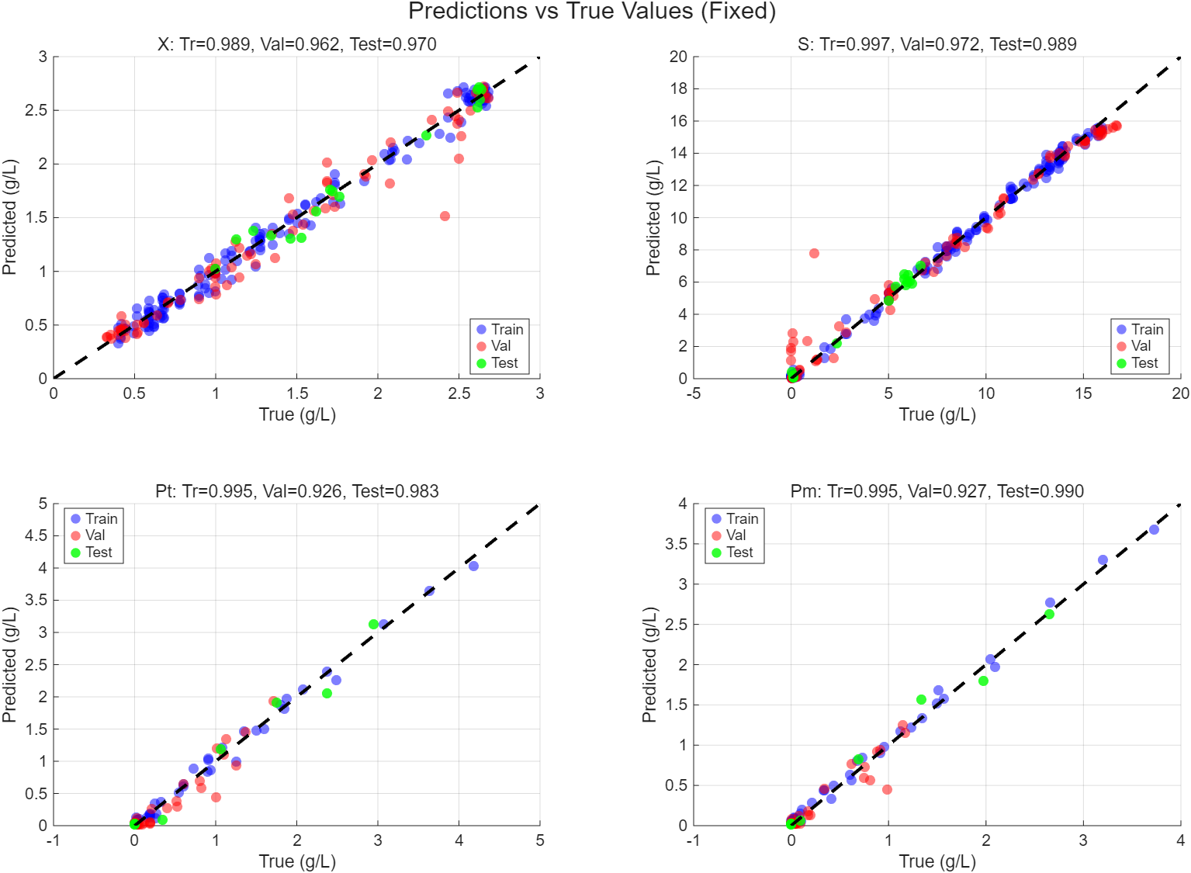
Training Convergence
Experimental results
Notes:
Here we compare predictions with true values for the four variables.
Each plot shows predicted values versus true values.
The dashed line is the ideal case: prediction equals true value.
Most points are close to the dashed line, so the accuracy is high.
We also report R2 for train, validation, and test.
In general, test R2 is very high for all variables, close to 1.
We can also see that the validation scores for Pt (Total product and) Pm (Secreted product) are a bit lower than X (Biomass) and S (Substrate).
This suggests product variables are harder, because they depend on many factors and errors can accumulate.
But the overall performance is still strong, especially on the unseen test batch.

Slide 17
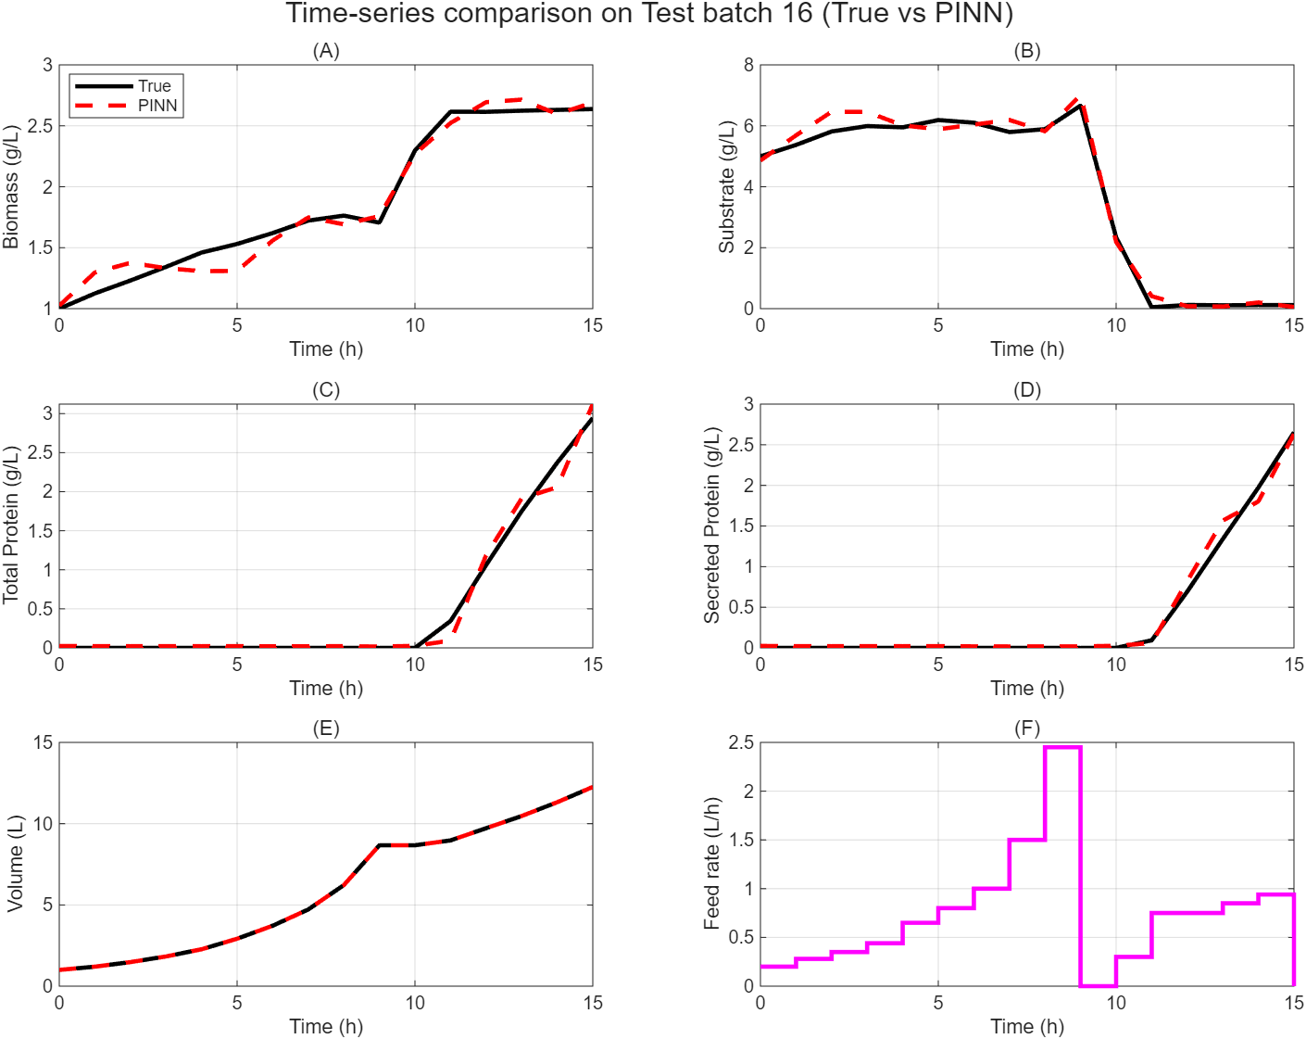
Quantitative Accuracy
Experimental results
Notes:
This slide shows the time-series comparison on the unseen test batch, Batch 16.
Black is the true trajectory, and the red dashed line is the PINN prediction.
For biomass XXX and substrate SSS, the prediction follows the true curve well over time.
For PtP_tPt(Total product and) and PmP_mPm(Secreted product) , the model captures the main trend, especially the increase in the late stage.
There is a small difference near the end, but the overall shape is correct.
For volume VVV, the match is almost perfect because volume is computed from dVdt=F in our setup.
The last plot shows the feed rate F(t), which has step changes.
Even with these changes, the model remains stable.
So this figure shows good generalization on Batch 16.

Slide 18
Discussion & Conclusion

Slide 19
Three Modeling Options
Discussion & Conclusion
Pure physics model: interpretable and physically consistent, but accuracy drops if kinetics/parameters are wrong.
Pure NN (data-driven): best accuracy when data are sufficient, but can overfit and may violate physics.
PINN: adds physics as a regularizer → slightly less accurate than pure NN in our runs, but more reliable with limited/noisy data and better physical plausibility.
Takeaway: use pure NN when data are rich; use PINN when data are scarce or you need physically consistent predictions.
Notes:
In conclusion, we compared three approaches.
A pure physics model is easy to interpret and follows physics, but it can be inaccurate if the kinetics or parameters are not correct.
A pure neural network can be more accurate when we have enough data, and in our experiments it performs better than PINN in terms of prediction error.
However, with limited or noisy data, it may overfit and may break physics.
PINN adds physics constraints as a regularizer, so it gives stable and physically meaningful results when data are not enough.
So, with rich data we prefer pure NN, but with limited data we prefer PINN.

Slide 20
Thanks!

Slide 21
REFERENCES

Slide 22
REFERENCES
[1] Thirugnanasambandam, Monesh kumar et al. “A Physics-Informed Neural Network (PINN) Framework for Generic Bioreactor Modelling.” Computers & chemical engineering 203 (2025): 109354. Print.
Notes:
In conclusion, we compared three approaches.
A pure physics model is easy to interpret and follows physics, but it can be inaccurate if the kinetics or parameters are not correct.
A pure neural network can be more accurate when we have enough data, and in our experiments it performs better than PINN in terms of prediction error.
However, with limited or noisy data, it may overfit and may break physics.
PINN adds physics constraints as a regularizer, so it gives stable and physically meaningful results when data are not enough.
So, with rich data we prefer pure NN, but with limited data we prefer PINN.

